Slide 1
HR Analytics Case Study
Team 123

Slide 2



This is our team.
Chris
Wesam
Krishna
K-12 Education Administrator
Gallup Certified Strengths Coach
Business Analyst
18 years experience
Principal Data Scientist
18 years experience

Slide 3

“The cost of replacing an individual employee can range from one-half to two times the employee's annual salary.”
Source: Gallup

Slide 4

More Than Money
Project Delays
Institutional Knowledge
Company Culture
Lost Productivity
Opportunity Costs
Workload on remaining employees
Source: Chally

Slide 5

Hiring Costs
42 days on average to fill open position
Recruiting Costs
Training Costs
Company Culture
Source: Chally

Slide 6
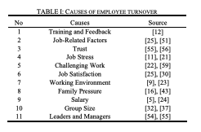
Employee Turnover: Causes, Importance, and Retention Strategies
European Journal of Business Management and Research
Authors:
Walid Abdullah Al-suraihi
Aida Siti
Abdullah Al-Suraihi
Shaq Ibrahim

Slide 7
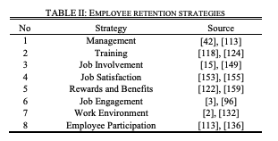
Employee Turnover: Causes, Importance, and Retention Strategies
European Journal of Business Management and Research
Authors:
Walid Abdullah Al-suraihi
Aida Siti
Abdullah Al-Suraihi
Shaq Ibrahim

Slide 8
Initial Hypothesis
Age: Younger employees tend to leave more frequently than older
Monthly Earnings: employees who earn more are less likely to leave
Work Life Balance: employees who rate themselves as having poor work life balance are more likely to leave than others
Gender: employee gender does not make an employee more or less likely to leave
Business Travel: employees who travel more frequently are more likely to leave the company than those who do not travel frequently
Environment Satisfaction: employees who rate their environmental satisfaction as low are more likely to leave than those who rate their environmental satisfaction higher
Notes:
Relationship with manager
How long have the employee and manager worked together?
How does the manager rate their performance?
Employee wellbeing
How satisfied is the employee with their environment?
Does the employee report being satisfied with their job?
Does the employee report have work-life balance? Does commute time play a role in this? How often does the employee travel?
Role/Preparation
What department does the employee work in?
What did they study?
How much ongoing training are they receiving?

Slide 9
Approach
Logistic regression model
Which factors are most significant/predictive of employee attrition?
Work with managers on improving those factors?
Ie: worklife balance -> casual Fridays or cater lunch

Slide 10
Overview of Data
Notes:
Hi,
My name is Wesam Alnasr and I will walk you through the data overview section.

Slide 11
Checklist of section (to be deleted later)
How involved was the cleaning process?
What were your key variables?
Any interesting insights from EDA?
If you used feature engineering how and was it successful?
Where did the dataset come from?
Super quick overview of the data

Slide 12
4,410 Employees
16% Employee Attrition Annually
Notes:
Based on the proposed problem statement, we have data for 4410 employees with a stated attrition rate of about 16%.

Slide 13
The Dataset
Employee Survey
Environment Satisfaction, Job Satisfaction, Work Life Balance
Manager Survey
Job Involvement, Performance Rating
General Data
Age, Travel Demands, Department, Commute Distance, Education, Education Field, Gender, Job Level, Job Role, Marital Status, Monthly Income, Salary Raise, Stock Options, Total Working Years, Training Received, Years at Company, Years Since Last Promotion, Years with Current Manager
Notes:
The original dataset collection of this case study has several datasets. We only focused on three of them which are:
Employee Survey: that has Environment satisfaction, Job satisfaction and worklife balance
Manager Survey: which has job involvement and performance rating
And general data set: that includes other information like: age, travel demands, department, education… and others that are listed in the slide.

Slide 14
Cleaning and Preparation Process
Merged data frames in one (EmployeeID)
4,410 Observations
29 Variables
3103: Training
1309: Testing
Notes:
We started our cleaning and preparation process by:
First: Merging the three generated data frames from our datasets.
A total of 4,410 observations as stated before that we did split into 3103 training set and 1309 testing set.
The compiled data frame had 29 different variables.

Slide 15
Cleaning and Preparation Process
Data Types Conversion
Character Variables
Attrition
BusinessTravel
Integer Variables
Education
Department
EducationField
Gender
JobLevel
MaritalStatus
JobSatisfaction
JobInvolvement
PerfromanceRating
StockOptionLevel
WorkLifeBalance
EnvironmentalSatisfaction
Notes:
In the second step of the cleaning process, we applied data types conversion to ease dealing with data.
We identified several variables that are denoted as characters, namely: Attirtion, Business Travel, Department, Education Field, Gender, Job level and marital status.
We also identified variables that are denoted as integers, namely: education, worklife balance, environmental satisfaction, job satisfaction, job involvement, perfroamnce rating and stockOptionLevel.

Slide 16
Cleaning and Preparation Process
Data Types Conversion
Character Variables
Attrition
BusinessTravel
Integer Variables
Education
Department
EducationField
Gender
JobLevel
MaritalStatus
JobSatisfaction
JobInvolvement
PerfromanceRating
StockOptionLevel
WorkLifeBalance
EnvironmentalSatisfaction
1- Below College
2- College
3- Bachelor
4- Master
5- Doctor
Notes:
To further demonstrate: Education for example has 5 different values starting from 1-5 along with their meanings.

Slide 17
Cleaning and Preparation Process
Data Types Conversion
Character Variables
Attrition
BusinessTravel
Integer Variables
Education
Department
EducationField
Gender
JobLevel
MaritalStatus
JobSatisfaction
JobInvolvement
PerfromanceRating
StockOptionLevel
WorkLifeBalance
EnvironmentalSatisfaction
1- Bad
2- Good
3- Better
4- Best
Notes:
These are the values and meaning for WorkLife Balance

Slide 18
Cleaning and Preparation Process
Data Types Conversion
Character Variables
Attrition
BusinessTravel
Integer Variables
Education
Department
EducationField
Gender
JobLevel
MaritalStatus
JobSatisfaction
JobInvolvement
PerfromanceRating
StockOptionLevel
WorkLifeBalance
EnvironmentalSatisfaction
1- Low
2- Medium
3- High
4- Very High
Notes:
And these are the values and meanings for Environmental satisfaction, job satisfaction, job involvement and performance rating.

Slide 19
Cleaning and Preparation Process
Independent
Attrition
Dependent
Age
Dropped
EmployeeID
Over18
Monthly Income
JobLevel
Gender
WorkLifeBalance
EnvironmentStatus
PerformanceRating
BusinessTravel
Education
EducationField
MaritalStatus
DistanceFromHome
Department
JobRole
YearsAtCompany
JobInvolvement
EmployeeCount
StandardHours
Key Variables
Notes:
Based on the previous steps, we identified the listed variables. Of course our independent variable is attrition which the topic of this study. In the middle section we listed the dependent variables and in the right section we listed the irrelevant variables that we dropped.

Slide 20
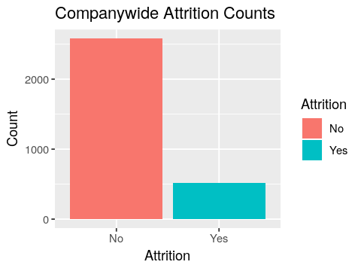
Exploratory Data Analysis and Insights
Notes:
After those three steps in the cleaning and preparation process of data, we conducted our exploratory data analysis and formulated our insights accordingly. Following are some examples only.
In this first chart, the plot indicated that the attrition rate is 16.8% in the training dataset. Based on this, we can conclude that although the class imbalance is not extreme, it is not a balanced dataset either. There are total of 521 records of employees who left the company vs 2580 records of employee who did not leave.

Slide 21
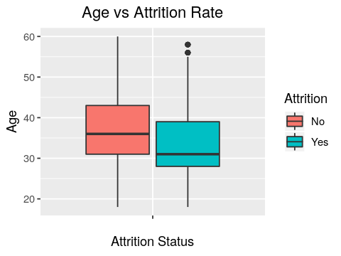
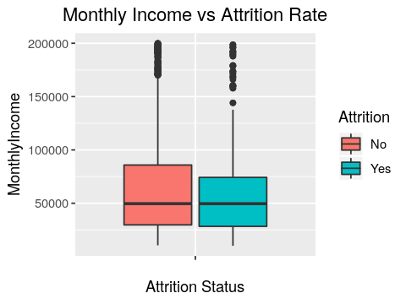
Exploratory Data Analysis and Insights
Notes:
In the left plot, the younger employees are more likely to leave the company than the older employees.
In the right plot, Monthly income seems to have many outliers. The boxplot indicates that there is no significant impact of Monthly Income on Attrition rate.

Slide 22
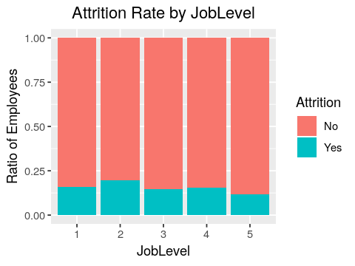
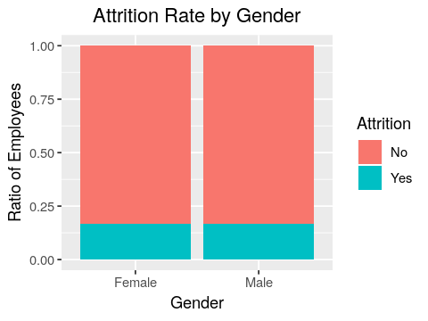
Exploratory Data Analysis and Insights
Notes:
In the left plot, the attrition is mostly similar across job levels but it is bit lower in higher job level, i.e., 5. This tells that JobLevel does not seem to affect Attrition Rate.
In the right plot, Gender does not seem to have any impact on employee Attrition Rate as well.

Slide 23
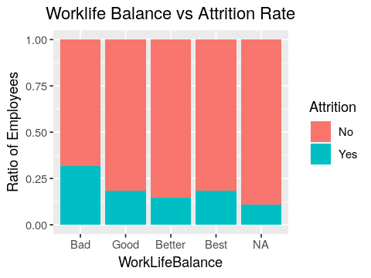
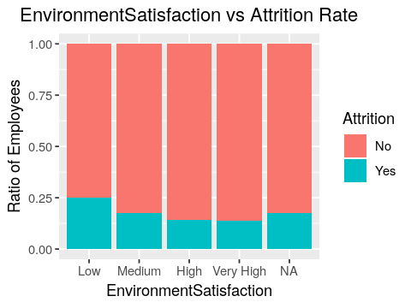
Exploratory Data Analysis and Insights
Notes:
In the left plot, Employees who rated to have a Bad worklife balance tend to leave more likely than others.
And on the right plot: Employees who have low work environment satisfaction tend to leave the company more likely than those than who have a better work environment satisfaction.

Slide 24
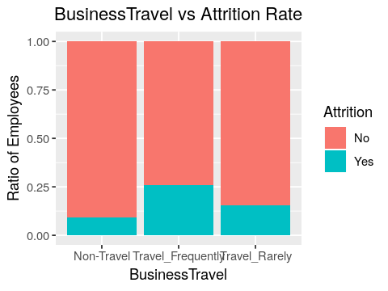
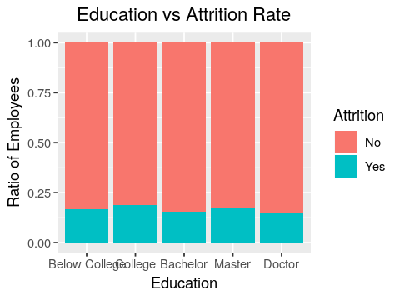
Exploratory Data Analysis and Insights
Notes:
In the left plot, employees who travel more frequently are more likely to leave the company than those who do not.
In the right plot, there is no strong relation between Education and attrition. Hence we can say that Education does not afftect the Attrition.

Slide 25
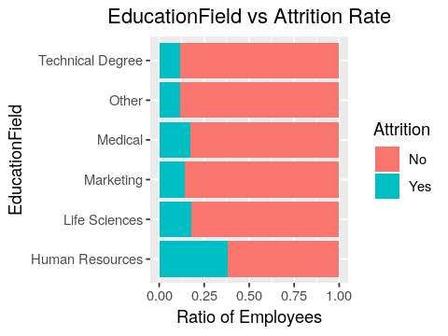
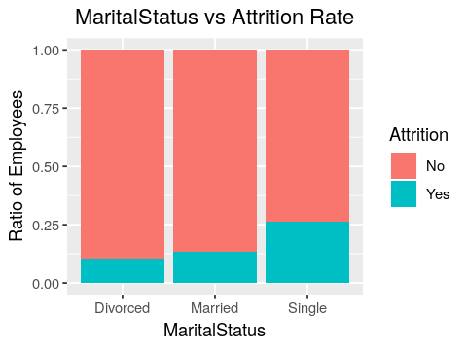
Exploratory Data Analysis and Insights
Notes:
In the left plot, employees who has studied Human Resources are more likely to leave the company than others.
While on the right plot, single employees are more likely to leave the company than Married or Divorced employees.

Slide 26
Final Selected Features
Selected
EnvironmentSatisfaction
Attrition
Unselected
Gender
JobSatisfaction
WorkLifeBalance
Age
BusinessTravel
Department
EducationField
JobRole
MaritalStatus
MonthlyIncome
YearsAtCompany
JobInvolvement
DistanceFromHome
Education
JobLevel
NumCompaniesWorked
PercentSalaryHike
TrainingTimeLastYear
YearsSinceLastPromotion
YearsWithCurrentManager
PerformanceRating
Notes:
Based on our EDA and insights, we concluded the final selection of variables. Our analysis included on the selected variables as seen on the slide.

Slide 27
Feature Engineering
Find and treat null values:
Total identified 56 rows with Null Values:
- “EnvironmentSatisfaction”
- “JobSatisfaction”
- “WorkLifeBalance”
Used Imputation because variables are categorical and number is small.
Notes:
After selecting our variables, we proceeded with a continuation of the cleaning process through feature engineering.
In the first step of feature engineering, we remediate the null values through imputation. A total of 56 rows identified with null cells that came from three columns: EnvironmentSatisfaction, JobSatisfaction and WorkLifeBalance. We popoulated them with the most frequent value in the column because the low number 56 vs. 4410.

Slide 28
Feature Engineering
Under Sampling:
To overcome and solve the imbalance of dataset:
- Originally: 16% attrition
- After Under Sampling: 35% Attrition Rate
Notes:
In the second step of feature engineering, we applied Under Sampling technique to overcome and solve the imbalance effect on the dataset. Orignally we had 16% attrition rate that was elevated to 35% attrition rate after under sampling.

Slide 29
Interesting insights from EDA
Bad worklife balance have higher attrition. Best worklife balance comes second.
Outstanding rated employees have higher attrition rate
Gender has almost no effect.
Notes:
And here are some interesting insights from our analysis.
Bad worklife balance have the highest attrition rate. However, the best worklife balance category came second after that.
Outstanding rated employees have higher attrition rate that others.
And last but not least, gender had no significant effect on the attrition rate.

Slide 30
Datasets Resources
https://www.kaggle.com/datasets/vjchoudhary7/hr-analytics-case-study?select=general_data.csv
Notes:
Our dataset is from Kaggle website through this URL.

Slide 31
Overview of Modeling

Slide 32

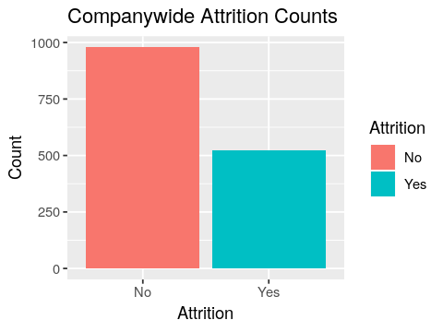
Imbalanced Dataset
Train dataset
Yes: 521 (16%)
No: 2580
Under sampled dataset
Yes: 521 (54%)
No: 979

Slide 33
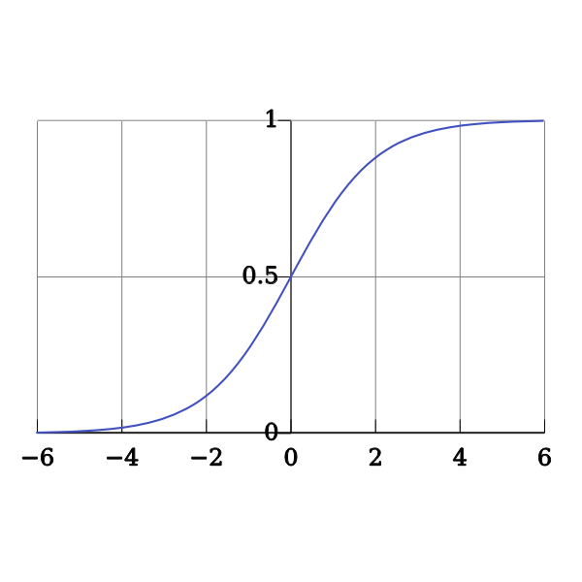
Types of Models
Classification
Logistic Regression
Decision Tree
Random Forest

Slide 34
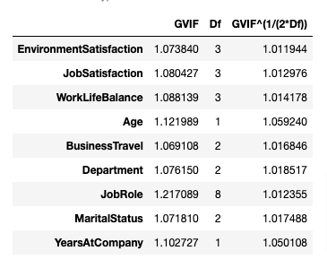
Logistic Regression
Step wise Selection
Checked for Multicollinearity
‘JobInvolvement’ dropped

Slide 35
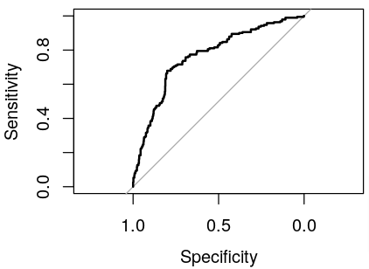
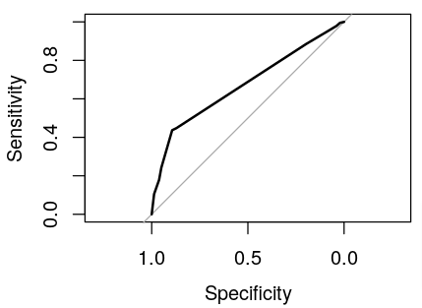
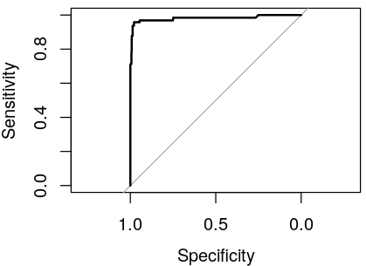
How do they compare – ROC Curves
Logistic Regression
Decision Tree
Random Forest
AUC: ~0.765
AUC: ~0.671
AUC: ~0.981

Slide 36
How do they compare – Confusion Matrix
Logistic Regression
Decision Tree
Random Forest
Actual | Predicted | Predicted
Actual |  | No | Yes
 | No | 953 | 166
 | Yes | 100 | 90
Actual | Predicted | Predicted
Actual |  | No | Yes
 | No | 1000 | 119
 | Yes | 107 | 83
Actual | Predicted | Predicted
Actual |  | No | Yes
 | No | 1094 | 25
 | Yes | 8 | 182

Slide 37
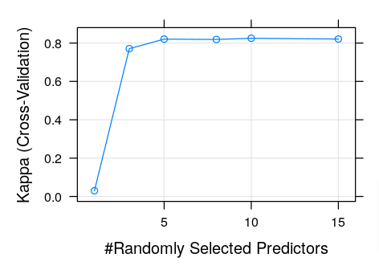
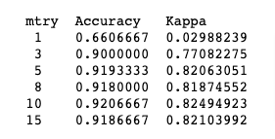
Model Optimization
Hyperparameter Tuning

Slide 38
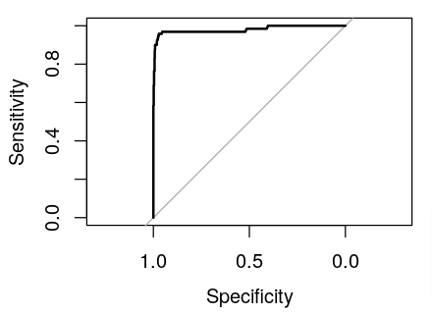
Optimized Model
Confusion Matrix
ROC Curve
Actual | Predicted | Predicted
Actual |  | No | Yes
 | No | 1090 | 29
 | Yes | 10 | 180

Slide 39
Closing Thoughts
Random Forest model is the best performing model
Models were trained on undersampled training data
Evaluated on un-touch test data
AUC was chosen over accuracy for evaluation

Slide 40
Thank you

Slide 41
Sources
Al-Suraihi, W. A., Samikon, S. A., Al-Suraihi, A.-H. A., &amp; Ibrahim, I. (2021). Employee turnover: Causes, importance
and retention strategies. European Journal of Business and Management Research, 6(3), 1–10. https://doi.org/10.24018/ejbmr.2021.6.3.893
CHOUDHARY, V. I. J. A. Y., &amp; Kumar, A. (2018, August 9). HR Analytics Case Study. Retrieved June 22, 2022, from
https://www.kaggle.com/datasets/vjchoudhary7/hr-analytics-case-study?select=general_data.csv.
Library, C. (2022, April 28). The real cost of employee turnover&nbsp;. Chally. Retrieved July 2, 2022, from
https://chally.com/blog/causes-and-cost-of-unwanted-turnover/#:~:text=Once%20an%20ideal%20candidate%20is,%242%2C792%20and%20%244%2C425%20per%20employee
Wigert, S. M. F. and B. (2019, March 13). This fixable problem costs U.S. businesses $1 trillion. Gallup.com. Retrieved July 1, 2022,
from https://www.gallup.com/workplace/247391/fixable-problem-costs-businesses-trillion.aspx#:~:text=The%20cost%20of%20replacing%20an,to%20%242.6%20million%20per%20year

Slide 42
Appendix

Slide 43
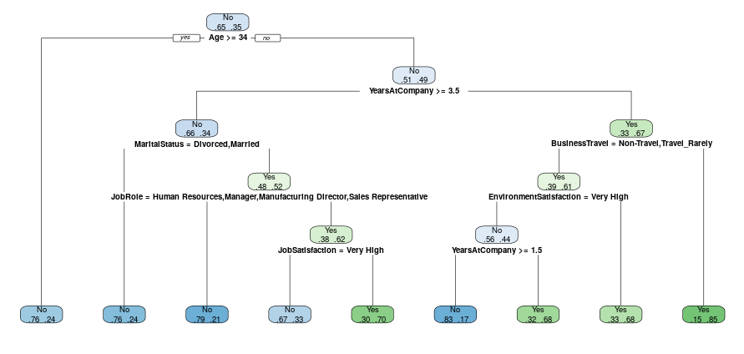
Decision Tree

Slide 44
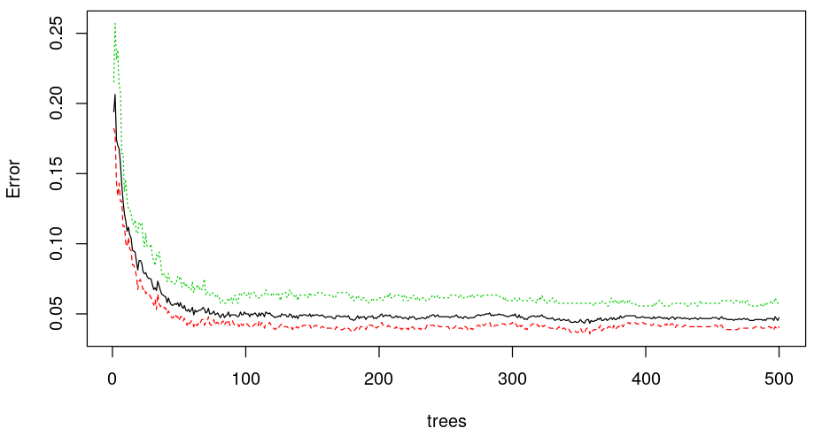
Random Forest

